Slide 1
A study of the Fermi bubbles near the Galactic plane
Dmitry Malyshev,
Laura Herold
Fermi LAT diffuse meeting
March 6, 2018

Slide 2
General information about the project
People involved:
Dima Malyshev, Laura Herold
Category of project: II
Follow up work on the bubbles
Some results on the bubbles at low latitudes were already published in:
the Fermi LAT diffuse paper (arxiv:1602.07246)
the pass 8 GC analysis paper (arxiv:1704.03910)

Slide 3
Motivation
Origin of the Fermi bubbles
AGN-like emission from Sgr A*
Bubbles are expected to have an hour-glass shape centered at the GC
Starburst / star formation
Bubbles don’t need to be centered at the GC

Slide 4
Properties of the bubbles at high latitudes
Fermi LAT bubbles analysis paper (arxiv:1407.7905)
Bubbles at latitudes |b| > 10 deg
Homogeneous spectrum with a cutoff around 100 GeV
Homogeneous intensity + cocoon

Slide 5
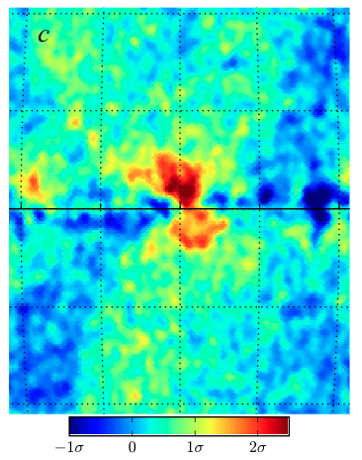
Previous analysis near the Galactic plane
Hints of a different behavior near the Galactic center
No cutoff at high energies
Higher intensity near the GC
Displaced from the GC to the right (negative longitudes)
Fermi LAT diffuse model
Acero et al (2016) arxiv:1602.07246
Pass 8 GC analysis Ackermann et al (2017)
arxiv:1704.03910

Slide 6
Goals of the new analysis
Test the features of the Fermi bubbles near the Galactic plane:
Larger intensity than at high latitudes
Emission displaced to the right from the GC
Spectrum without a cutoff around 100 GeV
Usually there are many assumptions made in the analysis -> hard to argue that the features are in the data and not an artifact of the analysis
We will start with very simple empirical models of the foreground emission (such as using low energy data to model the foreground at high energies) and increase the complexity from one model to another
At the end we compare the simple empirical models with a GALPROP model

Slide 7
This analysis
Data selection:
Pass 8 Source class (relatively small area)
9 years (August 4, 2008 – August 3, 2017)
Energies between 316 MeV – 1 TeV in 21 logarithmic energy bins (6 per decade)
Zenith angle cut at 100º
HEALPix pixelation order 7 (resolution 0.°46)
Analysis strategy:
Asymmetry in the data (point sources are masked)
Low-energy Fermi data as a template of foreground emission
Template of the bubbles modelled by “rectangles”+ low-energy-data template
GALPROP + isotropic, bubbles, Loop I, etc. + point-source refitting model

Slide 8
Asymmetry in the data
Asymmetry in the data with point sources masked (symmetrized)
Difference in every 4º latitude stripe = Average over region west (-10º, 0º) – east (0º , 10º )
Grey lines: Latitude stripes |b| > 10º

Slide 9
The low-energy model
Fit the data in energy bins between 1 GeV and 1 TeV in 4° latitude stripes by a combination of two templates:
Low-energy Fermi data (316 MeV – 1 GeV): N_{low} → spatial template for the softer foreground emission components
Isotropic (in a latitude stripe) component: c → extragalactic diffuse + (part of) IC
Region of bubbles is excluded (-20° < l < 20°)
200 brightest point sources are masked
The high energy data is smoothed with a 1º Gaussian kernel (this corresponds to containment angle of about 1º.5) to account for the difference in PSF between the model and the data bin

Slide 10
Low-energy model residuals

Slide 11
Low-energy model residual spectra

Slide 12
Low-energy model: Dependence on energy range and data class
Dotted with markers: Source class
Solid: Ultraclean class

Slide 13
The rectangles model
Components:
As before: N_{low}, c
Rectangles covering the Fermi bubbles (divided in east and west): b_{e} (0º, 10º), b_{w} (-10º, 0º)
Normalization coefficients N_{low}, c, b_{e}, and b_{w} are fitted to higher-energy data in 4° latitude stripes
Point sources are masked

Slide 14
Rectangles model: Dependence on energy range and data class
Dotted with markers: Source class
Solid: Ultraclean class

Slide 15
GALPROP model + PS refitting
Same analysis as in the Pass 8 GC excess study (Sample model + PS refitting near the GC)
Templates:
Gas correlated (π⁰ and brems) in 5 rings
IC in 3 components corresponding to IR, starlight, CMB
Geometric Loop I, Sun, Moon, Isotropic
Bubbles at |b| > 10 deg
GC excess (gNFW template)
3FGL point source + refit 40 brightest within R = 10º
Mask 200 brightest PS outside R = 10º
Fit independently in energy bins up to 1 TeV

Slide 16
GALPROP residuals
Residual + bubbles + GC excess:

Slide 17
Latitude profiles
Longitude profiles east and west of GC (-10° < l < 10°)
Models agree well for negative longitudes
Large oversubtractions for positive longitudes near the Galactic plane
Left-right asymmetry in the models

Slide 18
Spectra in the Galactic plane
Spectra east and west of GC (-10° < l < 10°)
Difference of data: west – east > 0
Left-right asymmetry in models: harder spectrum west of GC

Slide 19
Spectra in the Galactic plane
Spectra east and west of GC (-10° < l < 10°)
→ Agreement of GALPROP with other models is much better just outside of the Galactic plane, where there are not so many oversubtractions in the GALPROP model

Slide 20
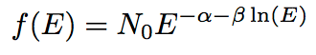
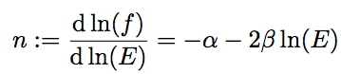
Log parabola fit
We fit a log parabola the inclination at energy E is we compare (2 – n) at E = 500 GeV for different models as a function of latitude

Slide 21
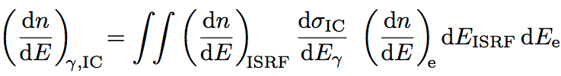
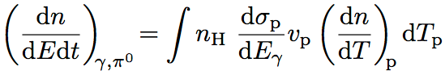
IC and Pi0 models
Data points from low-energy model

Slide 22
IC and Pi0 models
In the region b = (-6º, 6º), l = (-10º, 0º) no cutoff visible
Characteristic cooling time for a 1 TeV electron is ~ 300 kyr
Escape time for Δb = 6º ~ ΔH = 0.7 kpc is ~ 100 kyr
→No breaks => characteristic age of the particles is less than the cooling and escape times ~< 100 kyr
This is a relatively young population of either electrons and/or protons
Energy density of electrons (1 GeV – 1 TeV): 5 meV/cm^3, energy density of protons: 380 meV/cm^3 for gas density of 1/cm^3
Total energy in electrons ~3e50 erg
Notes:
Energy density of electrons: 5 meV/cm^3 energy density of protons: 84 meV/cm^3 for gas density of 1/cm^3
Total energy in electrons ~10^51 erg

Slide 23
Conclusions
In the analysis we confirm that
the intensity of the emission in the bubbles region is larger in the Galactic plane
the spectrum does not have a cutoff at around 100 GeV
the emission is shifted to the right from the GC
Important consequences for a possible detection of the bubbles with
Cherenkov telescopes (HESS, CTA)
Neutrino observatories (IceCube, KM3NeT)
23

